Slide 1
PROBABILITY & STATISTICS
Chapter 3: Discrete Random Variables and Probability Distributions
LEARNING OBJECTIVES
1. Discrete random variables
2. Probability mass function (Hàm xác suất) and cumulative distribution function (hàm phân phối tích lũy)
3. Mean and Variance (TB và Phương sai)
4. Discrete Uniform Distribution (Phân phối đều)
5. Binomial Distribution (Phân phối nhị thức)
6. Poisson Distribution (Phân phối Poisson)

Slide 2
Discrete Random Variables
D.R. variables
Definition
A discrete random variable is a random variable with a finite or countably infinite range.
Example
1. Roll a die twice: Let X be the number of times 4 comes up then X could be 0, 1, or 2 times.
2. Toss a coin 5 times: Let X be the number of heads then X = 0, 1, 2, 3, 4, or 5.
3. X = The number of stocks in the Dow Jones Industrial Average that have share price increases on a given day then X is a discrete random variable because whose share price increases can be counted.

Slide 3
Discrete Random Variables
D.R. variables
Determining a Discrete Random Variable
Let X be a discrete random variable with possible outcomes x₁, x₂, … , x_{n}.
1. Find the probability of each possible outcome.
2. Check that each probability is between 0 and 1 and that the sum is 1.
3. Summarizing results in following table:
X | x₁ | x₂ | …. | x_{n}
P(x) | p₁ | p₂ | …. | p_{n}

Slide 4
Discrete Random Variables
Example
D.R. variables
Let the random variable X denote the number of heads in three tosses of a fair coin. Determine the probability distribution of X.
The sample space:
S = {HHH, HHT, HTH, HTT, THH, THT, TTH, TTT}.
The events: [X = 0] = {TTT} [X = 1] = {HTT,THT,TTH}
[X = 2] = {HHT, HTH,THH} [X = 3] = {HHH}
X | 0 | 1 | 2 | 3
P(x) | 1/8 | 3/8 | 3/8 | 1/8

Slide 5
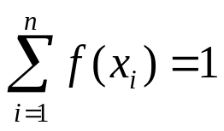
Probability mass function
Definition
For a discrete random variable X with possible values x₁, x₂, …, x_{n} , a probability mass function is a function such that
(1) f(x_{i}) ≥ 0
(2)
(3) f(x_{i}) = P(X = x_{i})
PMF & CDF
In above example, we have
f(0) = 1/8, f(1) = 3/8, f(2) = 3/8 and f(3) = 1/8.

Slide 6
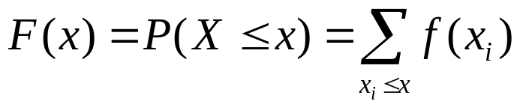
Cumulative distribution function
Definition
The cumulative distribution function of a discrete random variable X, denoted as F(x), is
For a discrete random variable X, F(x) satisfies the following properties.
(1) 0 ≤ F(x) ≤1
(2) If x ≤ y, then F(x) ≤ F(y)
PMF & CDF

Slide 7
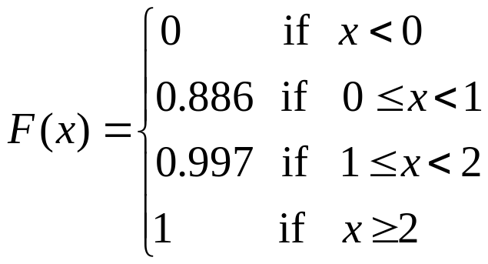
Cumulative distribution function
Example
Suppose that a day’s production of 850 manufactured parts contains 50 parts that do not conform to customer requirements. Two parts are selected at random, without replacement, from the batch. Let the random variable X equal the number of nonconforming parts in the sample.
What is the cumulative distribution function of X?
PMF & CDF
The first we find the probability mass function of X.
X | 0 | 1 | 2
f(x) | 0.886 | 0.111 | 0.003

Slide 8
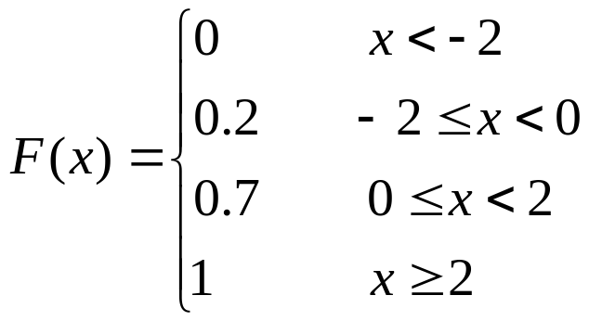
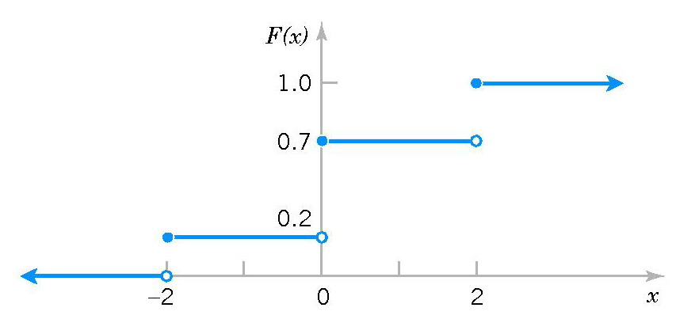
Cumulative distribution function
Example
Determine the probability mass function of X from the following cumulative distribution function:
PMF & CDF
f(-2) =0.2-0=0.2
f(0) =0.7-0.2=0.5
f(2) =1.0-0.7=0.3

Slide 9
SLOT 8
3.4 MEAN AND VARIANCE OF A DISCRETE RANDOM VARIABLE
Mean & Variance
3-5 DISCRETE UNIFORM DISTRIBUTION
3-6 BINOMIAL DISTRIBUTION

Slide 10
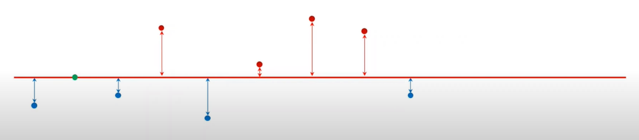

Mean and Variance
The mean or expected value:
The mean is a measure of the center
or middle of the probability distribution
Mean & Variance
The mean or expected value of the discrete random variable X, denoted as μ or E(X), is:
X | 0 | 1 | 2
f(x) | 0.886 | 0.111 | 0.003

Slide 11
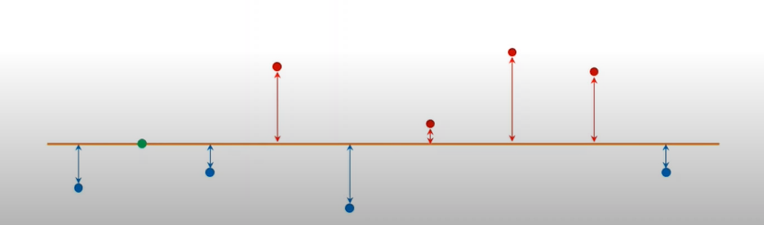









The variance discrete random variable:
The variance is a measure of the dispersion, or variability in the distribution
(b)
The variance of X, denoted as V(X) is:

Slide 12
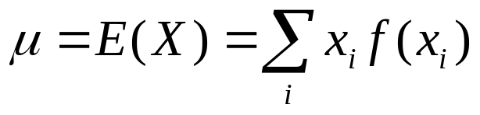
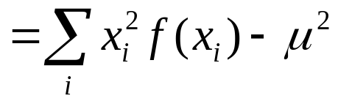
Mean and Variance
Definition
The mean or expected value of the discrete random variable X, denoted as µ or E(X) is
The variance of X, denoted as σ² or V(X) is
σ² = V(X) = E(X - µ)²
The standard deviation of X is σ.
Mean & Variance

Slide 13
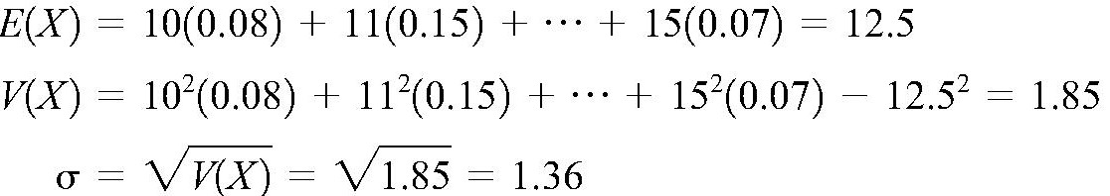
Mean and Variance
Example
The number of messages sent per hour over a computer network has the following distribution:
Determine the mean and standard deviation of the number of messages sent per hour.
Mean & Variance
X | 10 | 11 | 12 | 13 | 14 | 15
f(x) | 0.08 | 0.15 | 0.30 | 0.20 | 0.20 | 0.07

Slide 14
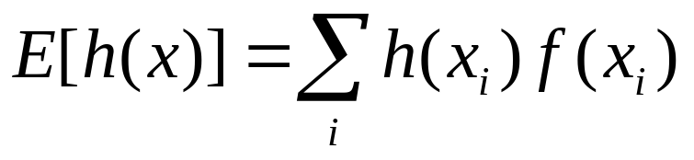
Mean and Variance
Mean of a Function of a Discrete Random Variable
If X is a discrete random variable with probability mass function f(x) then for any function h(x)
Mean & Variance
Corollary
E(aX + b) = aE(X) + b
V(aX + b) = a²V(X)

Slide 15


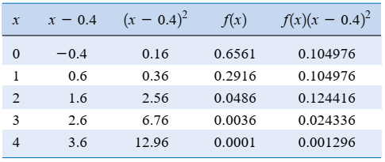
Mean and Variance
EX:
There is a chance that a bit transmitted through a digital transmission channel is received in error. Let X equal the number of bits in error in the next four bits transmitted. Suppose that the probabilities are
Mean & Variance

Slide 16

Mean and Variance
EX:
Mean & Variance
What is the expected value of the square
of the number of bits in error?

Slide 17
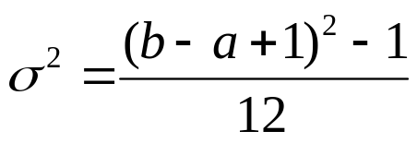
Discrete Uniform Distribution
Definition
A random variable X has a discrete uniform distribution if each of the n values in its range, say, x₁, x₂, …, x_{n} has equal probability. Then,
f(x_{i}) = 1/n
Uniform Dis.
Mean and Variance
Suppose X is a discrete uniform random variable on the consecutive integers a, a+1, …, b for a ≤ b. The mean and variance of X
µ = E(X) = (a + b)/2

Slide 18
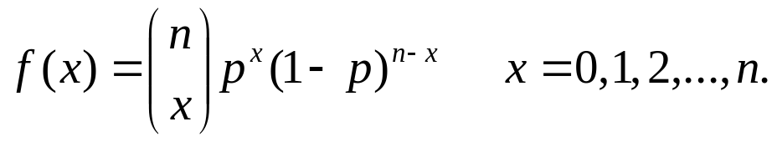
Binomial Distribution
Definition
A random experiment consists of n Bernoulli trials such that
(1) The trials are independent
(2) Each trial results in only two possible outcomes, labeled as “success’’ and “failure’’
(3) The probability of a success in each trial, denoted as p, remains constant
The random variable X that equals the number of trials that result in a success has a binomial random variable with parameters 0<p<1 and n=1,2,…The probability mass function of X is
Binomial Dis.

Slide 19
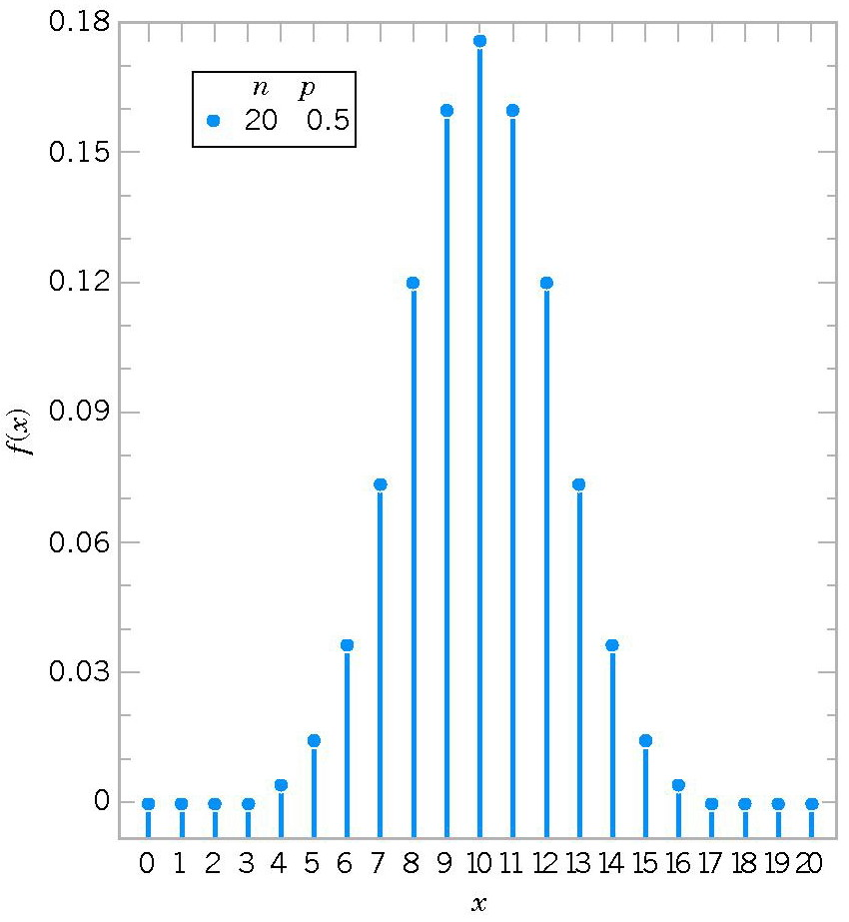
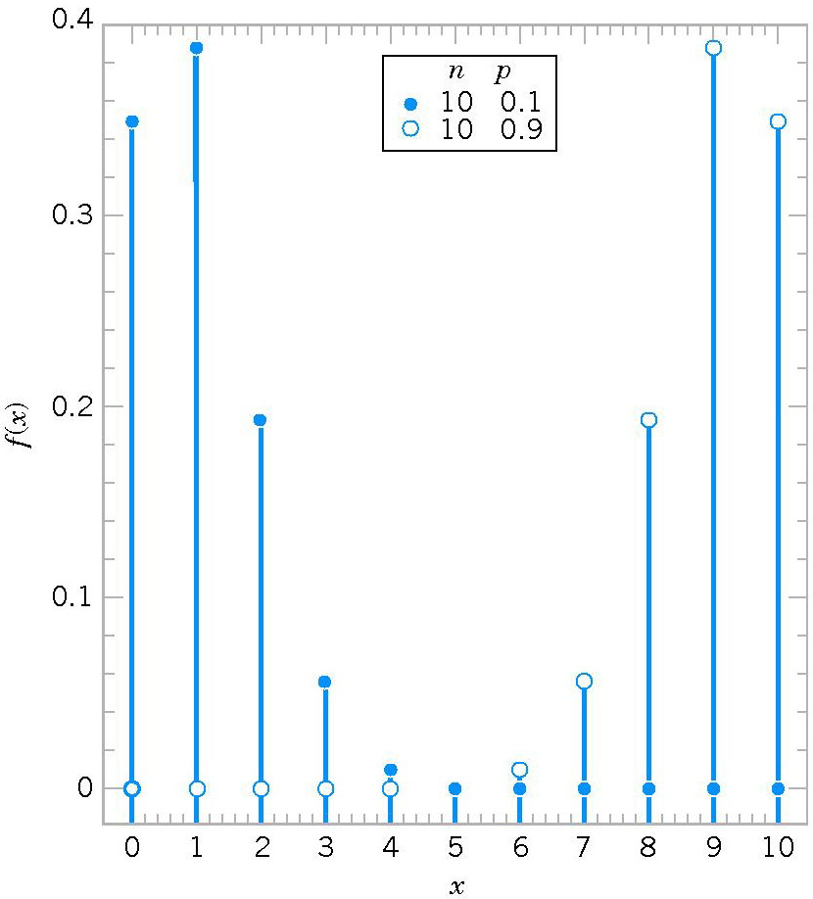
Binomial Distribution
Binomial Dis.
Binomial distributions for selected values of n and p.

Slide 20
Binomial Distribution
Mean and Variance
µ = E(X) = np σ² = V(X) = np(1-p)
Example
Each sample of water has a 10% chance of containing a particular organic pollutant. Assume that the samples are independent with regard to the presence of the pollutant.
(a) Find the probability that in the next 18 samples, exactly 2 contain the pollutant.
(b) Determine the probability that at least four samples contain the pollutant.
(c) Determine the probability that 3 ≤ X < 7.
Binomial Dis.

Slide 21
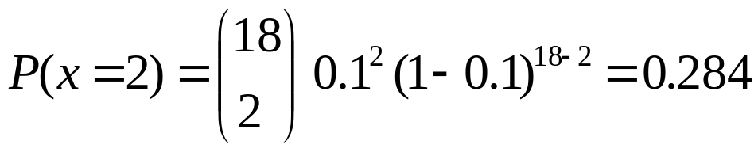
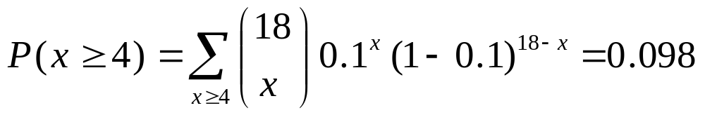
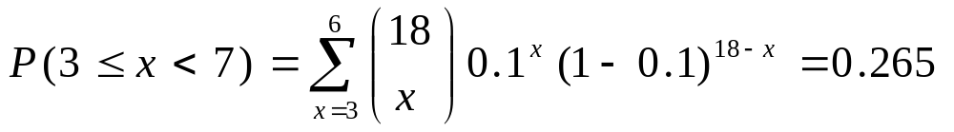
Binomial Distribution
Solution. Let X = the number of samples that contain the pollutant in the next 18 samples analyzed. Then X is a binomial random variable with p = 0.1 and n = 18.
(a)
Binomial Dis.
(b)
(c)

Slide 22
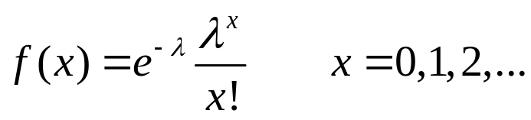
Poisson Distribution
Definition
Given an interval of real numbers, assume events occur at random throughout the interval. If the interval can be partitioned into subintervals of small enough length such that
(1) the probability of more than one event in a subinterval is zero,
(2) the probability of one event in a subinterval is the same for all subintervals and proportional to the length of the subinterval, and
(3) the event in each subinterval is independent of other subintervals, the random experiment is called a Poisson process.
The random variable X that equals the number of events in the interval is a Poisson random variable with parameter λ > 0, and the probability mass function of X is
Poisson Dis.

Slide 23
Poisson Distribution
Mean and Variance
If X is a Poisson random variable with parameter λ, then
µ = E(X) = λ σ² = V(X) = λ
Example
For the case of the thin copper wire, suppose that the number of flaws follows a Poisson distribution with a mean of 2.3 flaws per millimeter. Determine the probability of exactly 2 flaws in 1 millimeter of wire.
Determine the probability of at least 1 flaw in 2 millimeters of wire.
Poisson Dis.

Slide 24
Poisson Distribution
Let X denote the number of flaws in 2 millimeters of wire. Then, X has a Poisson distribution with
Therefore,
Poisson Dis.

Slide 25
Summary
We have studied:
1. Discrete random variables
2. Probability mass function and cumulative distribution function
3. Mean and Variance
4. Discrete Uniform Distribution
5. Binomial Distribution
6. Poisson Distribution
Summary
Homework: Read slides of the next lecture.

